Slide 1
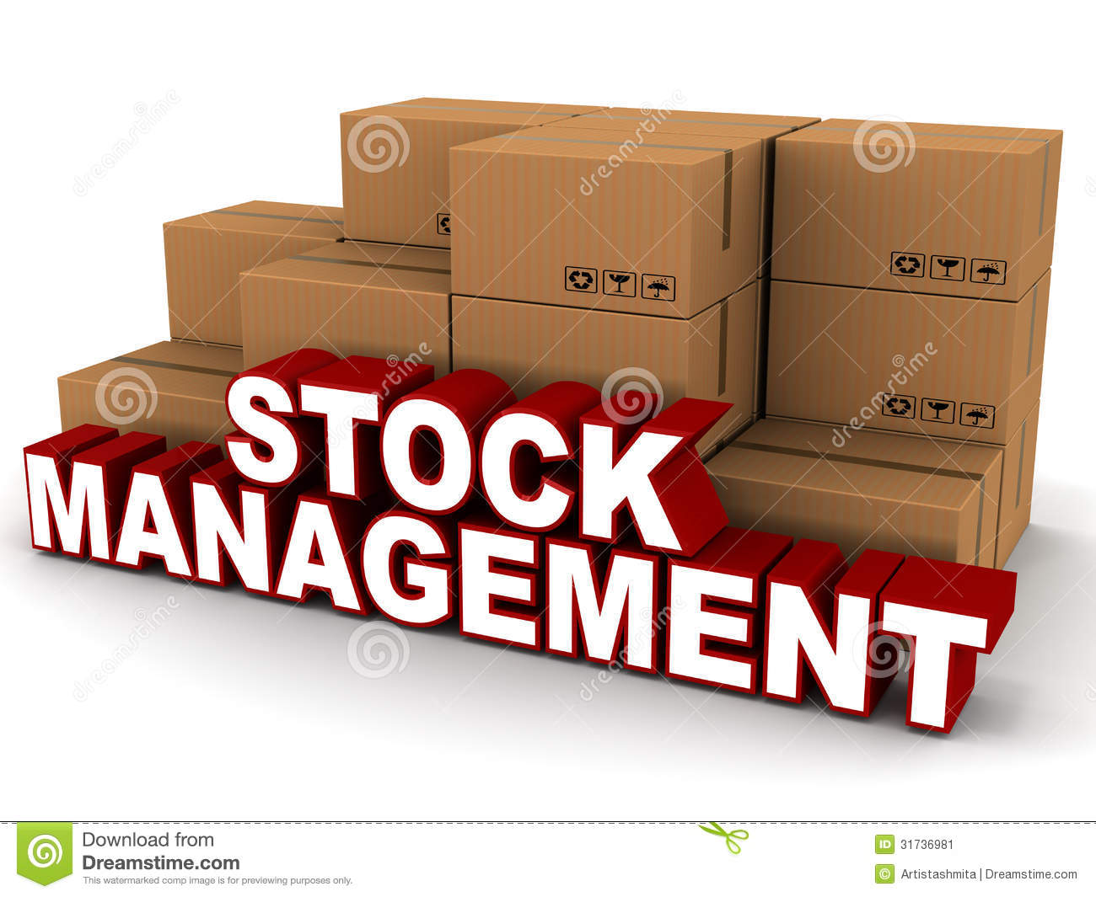
Stock Management System Mandira Tamang NCC ID:00172999

Slide 2
Stock Management System
Stock Management System is the system which is widely used to manage the product available in the warehouse or can manage in the shop as well.
It helps in the management of stock exchange and give the exact database management required.
This software involves the billing system as well of products.

Slide 3
Problem statement
This project is develop for the management of the stock exchange.
It helps to keep the stock record safely and provide the available product to the buyer who order it.
Currently it was difficult to manage the stock in systematic way. It was creating difficulty to keep record of stock and manage the orders which was costly as well as time consuming.
This project helps to solve these problems that provides the simple and effective management of the stock.

Slide 4
Background of project
Stock management system plays the vital role in the business field and helps to reach out the goal of the business.
It helps to keep the record of the stock and manage the order in the systematic way within the small period of the time.
It helps to maintain the quality of the product and save the time as well as the cost.
It helps to edit the stock available and create the bill of the product that is order by the buyer.
It is simple and easy to understand as well as the work flow in the smooth way.

Slide 5
Aims of Stock Management System
Followings are the aims of sms
The main aim is to manage the product available in the stock in the systematic way.
To keep the records of products and manage it properly in the database.
To display the available products and their details.

Slide 6
objectives of stock management system
To meet the given aims here are the objectives of sms
Firstly collecting the requirements
Designing the database for sms
Performing the installation
Performing the planning
Performing the testing
Performing the release

Slide 7
features
Following are the features of the stock management system
1.Customer management
It keeps the details of the customer and keep the record safely. It keeps the order of customer and provide with bill.
2.Point of sales management
It has the billing system which keep the record of payments. It helps to ensure the customer transaction complete correctly and keep the record safe.
3.Stock control
It manages the stock and keep the record of the stock. It shows the available of the stock and helps to edit the stock.
4.It provides the best security and keeps the data and information safely.
5. It helps to save the cost as well as time while approaching the data and information.

Slide 8
Work breakdown structure
It is the tool that helps to break the work into small pieces in order to manage and plan the project.
By breaking the work into small pieces we can build the check points and allow to measure the progress.
It is the key to planning out the project and helps to manage it properly.
The work breakdown structure of stock management is given down below:

Slide 9
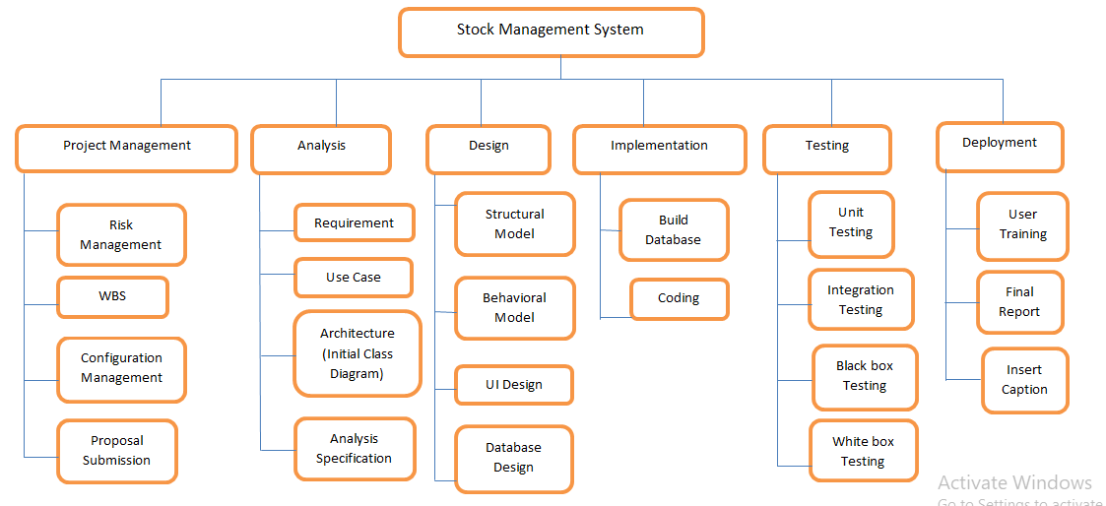
Diagram of work breakdown structure

Slide 10
Gantt chart
Gantt chart
It is the process of maintaining the record of the start and the end of the work or activity.
Its like the timetable which is maintain to manage and finish the work at the time.
Its main aim is to give the exact record of the work. That is why it play the vital role to develop the project which help to manage the project simply and effectively.

Slide 11
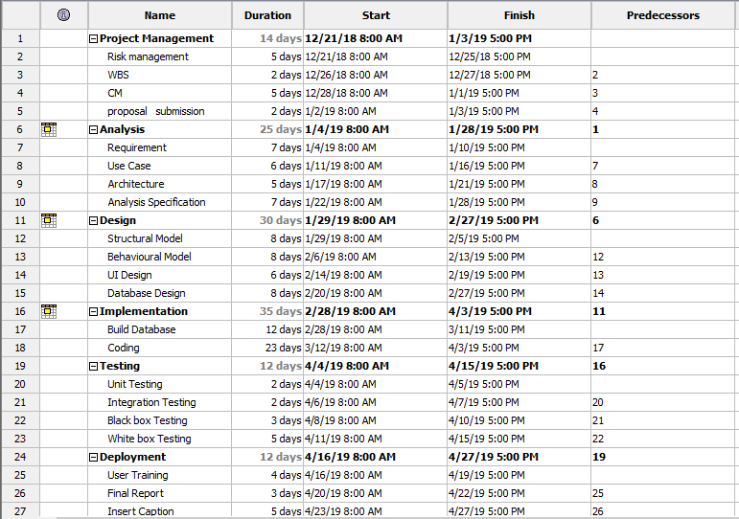
Diagram of Gantt chart

Slide 12
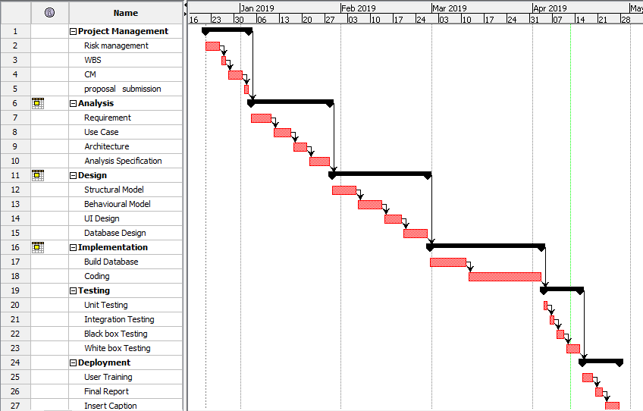
Gantt chart

Slide 13
Methodology used
There are different methodology which helps to complete the project in the systematic way and helps to develop the project that we need. Like waterfall, agile, etc.
Among the different methodology I have chosen the waterfall method to develop this project.
Waterfall method
It is the one of the best method that is used to develop the projects. Especially this method is used to develop the big projects like projects of governments, etc.
Waterfall method follows the rules and regulations.
It performs the work in the step wise which are analysis, design, implementation, testing and deployment.
These steps play the vital role to develop the project.
With the help of this method the work flow is like the waterfall where without completion of one stage it cannot go further in the other stages.

Slide 14
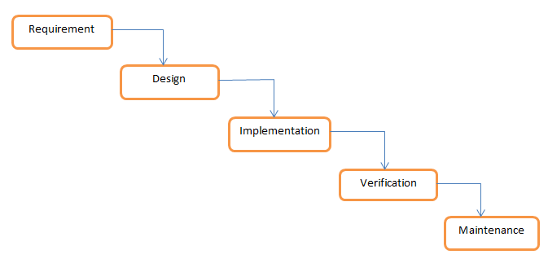
Diagram of waterfall method

Slide 15
System Architecture
System architecture
It is the conceptual model which defines the structure, behavior, and more views of a system. It is the representation of the system organized in a way that supports reasoning about the structures and behaviors of the system.
For the development of this project I used the Three Tier Architecture. It is the web based application which is divided into 3 layers
1.Presentation layer
It is the first layer which is handle by the client system.
It transfer the data to the application layer.
2. Application layer
It is the middle layer which is handle by the application server.
It helps to transfer the data between the presentation and database layer.
3.Database layer
It the third layer which is handle by the server system.
It helps to store and retrieve the information from database or file system.

Slide 16
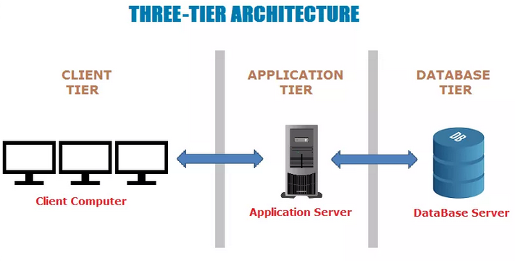
Diagram of three-tier architecture

Slide 17

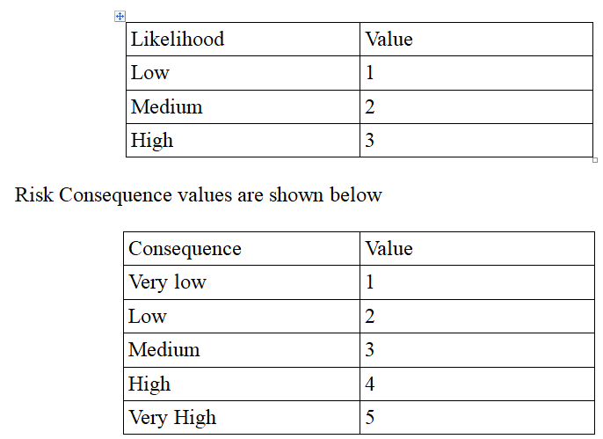
Risk management
Risk management is the process of the managing the risk that arise. As well while developing the project the risk can arise which leads to the lots of problems. So, risk management is required as the problems also can arise in the future.

Slide 18
Possible risks and its solutions
S. No | Risk type | Risks | Likelihood | Consequences | Impact | Solution
1 | technical | Loss of data | 2 | 2 | 4 | To avoid the data loss, it should be kept in the drive like for the backup.
2 |  | Server failure | 1 | 2 | 2 | Sometime the server can fail while doing the project. For prevention the security and backup should be maintained.
3 |  | Data theft | 2 | 3 | 6 | To avoid from data theft, should maintain the tide security to data with different methods like data encryption, etc.
4 |  | Threat on the system | 2 | 2 | 4 | Updating or scanning the system should be done time to time so that it will work smoothly.
5 | Non-technical | Lack of planning | 2 | 4 | 8 | The proper planning should be done to avoid the problems that may arise in the future.
6 |  | Insufficient resources | 2 | 4 | 8 | Collect the required resources for the project.
7 |  | Lack of budget | 2 | 3 | 6 | Do the proper use of budget and separate the little more budget for project.

Slide 19
Configuration management
It is the process of managing that everyone gets the correct latest and relevant documents whenever they check it.
It gives the information about the items that need to be configured.
Any changes like add, delete and modify the files with the help of configuration management.
The diagram of configuration management is given down below:

Slide 20
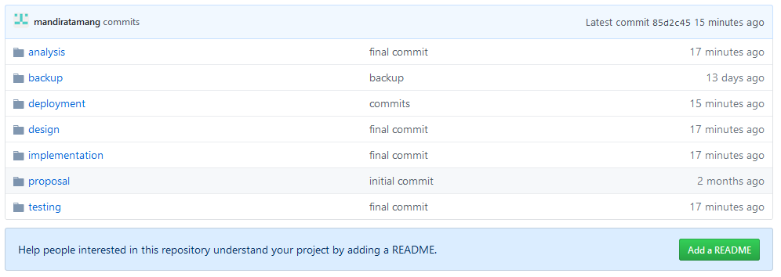
Configuration management

Slide 21
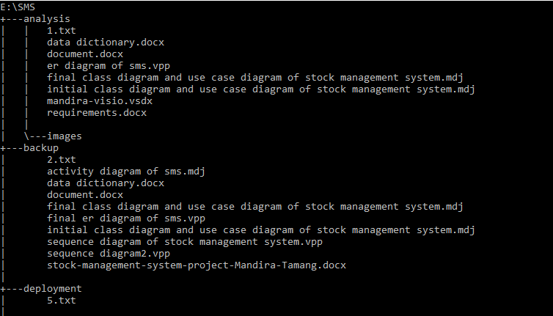
Configuration Management

Slide 22
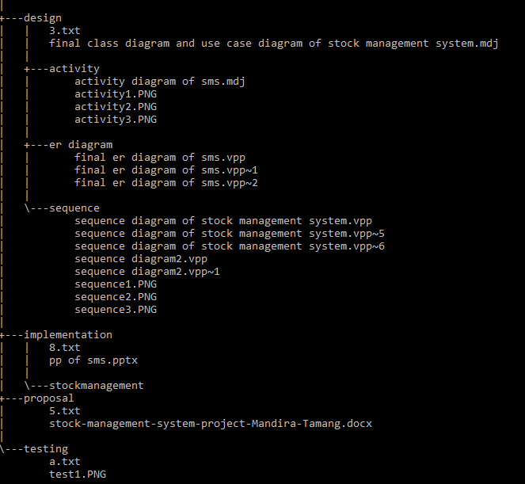
Configuration Management

Slide 23
Design pattern
It gives the solution to the common problems.
It helps to reduce to maintain the code easily.
It also helps for the code reusability.
So, for the better performance of the project I used the Model View Controller(MVC) design pattern.
Model View Controller
Model is responsible for getting and manipulating data (interact with database).
View is actually what the end user sees.
Controller acts as the middleman between the model and view. The controller ask the model to get some data from a database and then the controller take that data and load a view and pass that data into it.

Slide 24
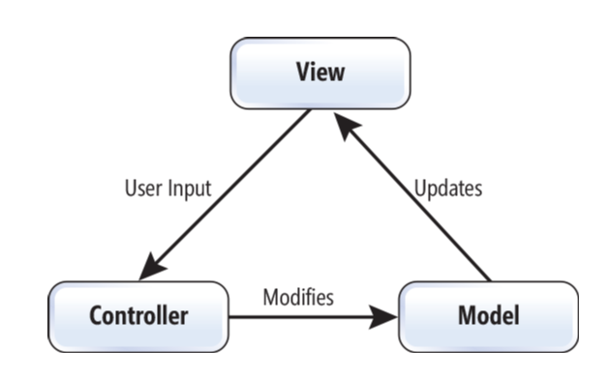
Diagram of mvc

Slide 25
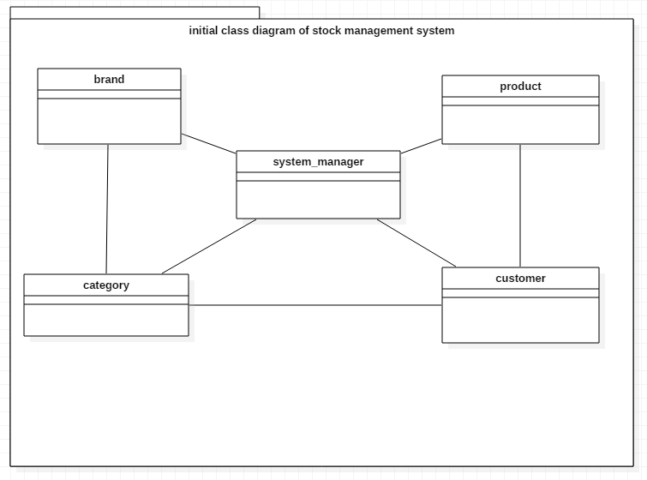
The class diagram of Stock Management System
Class diagram is graphical representation which involves different classes and relationship between them.
Class is made up of attributes and operations.
It helps to give the clear sketch of the system required.
It gives the information of system structure or design.
It is flexible.

Slide 26
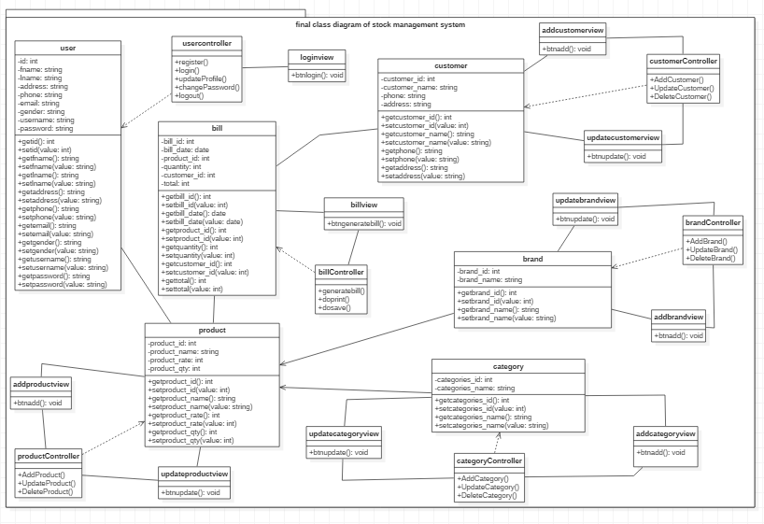
Final class diagram

Slide 27
Class diagram
The class diagram for stock management is given above.
The classes of Stock management system are user, product, category, brand and customer.
So the customer can buy the product that are available.
The class diagram for stock management system is made in the MVC design pattern as given in the figure.
The attributes and operation of classes also given clearly.

Slide 28
Use case diagram
It is the diagram which shows the relationship between the actor and the use cases.
Simply we can say that it shows the interaction of users with the system.
it helps to decrease the confusion and helps to show the interaction of user and system.
Justification
It helps to give the clarification of the system and how it interact with the user. Following are the reason for selecting this diagram
It helps to provide the clear understand of the system.
It has proven as the excellent bridge between the system and the user.
It also helps to give the function requirement of the system.

Slide 29
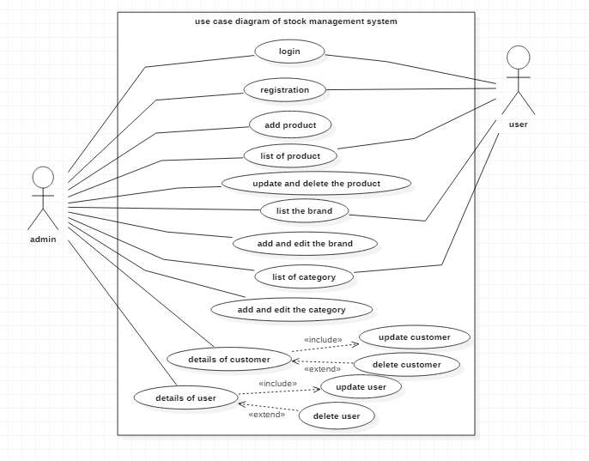
Use case diagram

Slide 30
Use case diagram
Here in the use case diagram, the admin and user are the actor who interact with the use cases.
Both the actor admin and user can register and login the system but admin should give the permission to the user.
The admin has right to control the system.
User only can control the system that the admin has allowed.

Slide 31
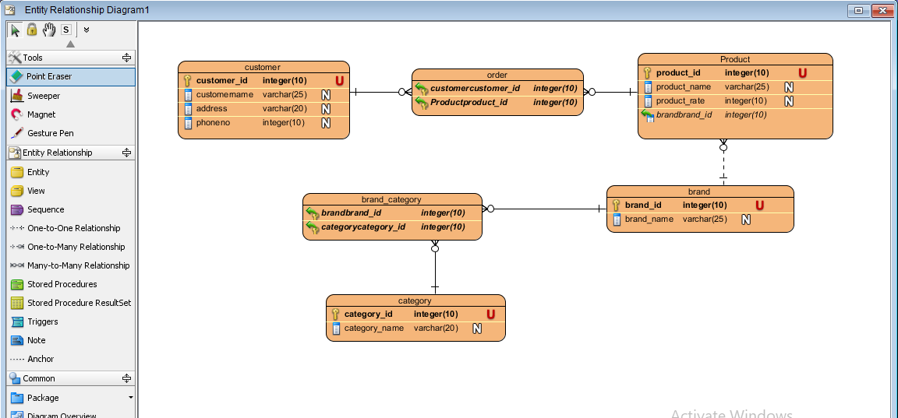
Er-diagram of stock management
Er-diagram is the visual representation which is like the class diagram but it involves the entities .
It shows the relationship between the entities.
It decreases the complication and provide the simple way to understand the system..
It is flexible as we can make other relationship from the existing ones..

Slide 32
Er diagram
There are six entities of er diagram of stock management system.
They are customer, order, product, brand, category and brand_category.
The customer and product forms the many to many relationship which is order.
As well the brand and category form the many to many relationship which is brand_category.
The brand and product forms the one to many relationship as shown in the diagram above.

Slide 33
Activity diagram of stock management system
Activity diagram is one of the most important diagram which shows the dynamic view of the system.
It shows the flow from one activity to another activity.
Justification
Following are the reasons for the selection of activity diagram
It shows the real work flows of the system.
It easily helps to understand the work flow of the system.
It is user-friendly as shows the actual work of the system.

Slide 34
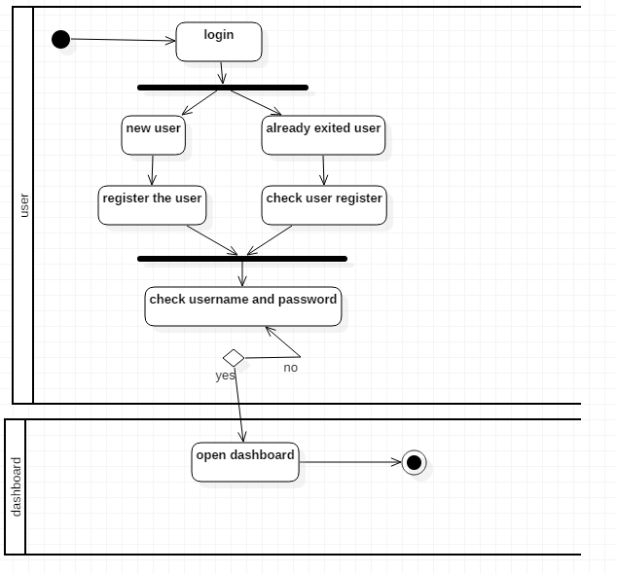
1. Activity diagram of login system of stock management system

Slide 35
1. Activity diagram of login
Firstly the user login in the system.
If its new user, then they can register and login.
If already exit, then they can enter their email and password and login.
After login, the dashboard will appear in the screen.

Slide 36
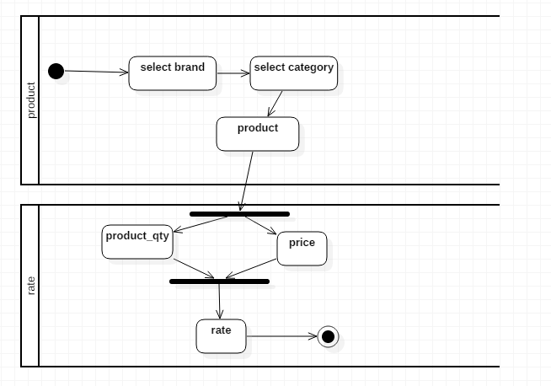
2. Activity diagram of stock

Slide 37
2. Activity diagram of stock
The admin can add the category, brand and product.
They can calculate the payment of the product.
To add the product, admin should select the brand and category. Then, name the product and make the payment.

Slide 38
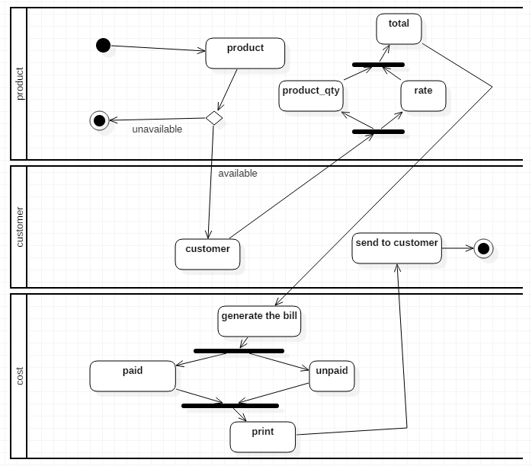
3. Activity diagram of selling the product to the buyer

Slide 39
3. Activity diagram of selling the product
To supply the product to the customer, firstly check the product is available or not.
If product is available then enter the information of customer who needed it.
Then make the payment of product.
Generate the bill.
Lastly send it to customer.

Slide 40
Sequence diagram
Sequence diagram
It is the diagram which helps to show the behave of the system.
It is made up of different components they are actor, object, lifeline, focus of control, message, etc.
Justification
It shows the object interaction which is arranged in the time sequence.
It shows the behavior of the system.
It interact among objects for the purpose of exchanging the message at the time.

Slide 41
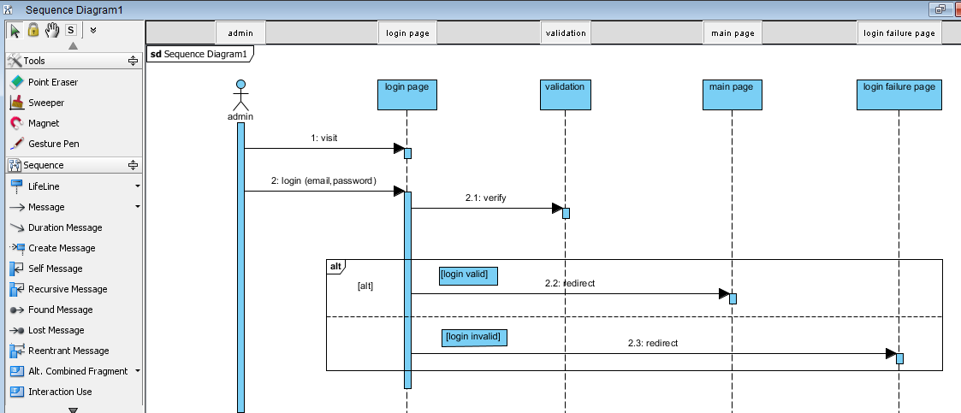
1. Sequence diagram

Slide 42
1. Sequence diagram
Here in this diagram, the admin is the actor. The login page, validation, main page and login failure page are the objects.
Firstly the admin interact with the login page object with the message visit. After visiting the page the actor enter the email and password.
To verify the email and password the login page object interact with the validation object with the message verify.
To know the valid or invalid email and password the process is working in the frame as shown in the diagram.
If login is valid then login page object interact with the main page object with the message redirect else (in case of invalid) then login page object interact with the login failure page with the message redirect.

Slide 43
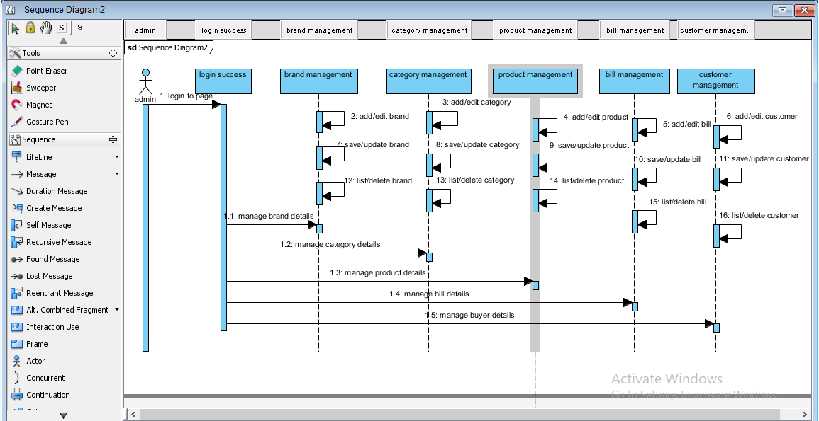
2. Sequence diagram

Slide 44
2. Sequence diagram
Likewise the admin is the actor in this diagram. The login success, brand management, category management, product management, bill management and customer management are the objects.
After the login success the admin actor interact with the login success object with the message login to page.
The admin can manage the brand with the interaction of login success object with the brand management object with the message manage the brand details.
In this way the admin can manage the category, product, bill and customer with the interaction of login success object with the category management, product management, bill management and customer management with the messages manage the category/product/bill/customer details.
To edit, add, save, list and delete the brand ,the brand management object interact with self as it is done in the brand management object.
Similarly, to edit, add, save, list and delete the category, product, bill and customer management the objects interact with self as shown in the diagram.

Slide 45
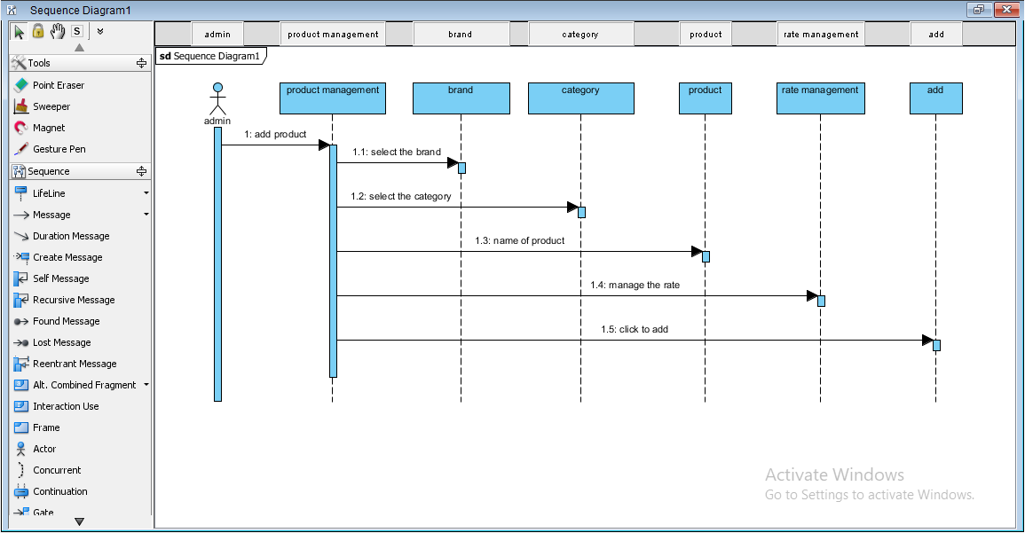
3. Sequence diagram

Slide 46
3. Sequence diagram
Here, the sequence diagram is of the adding the product.
Firstly to add the product go to the product management.
After entering select the brand.
After selecting brand, select the category.
Likewise after category, name the product and manage the rate.
Now, click to add to add the product.

Slide 47
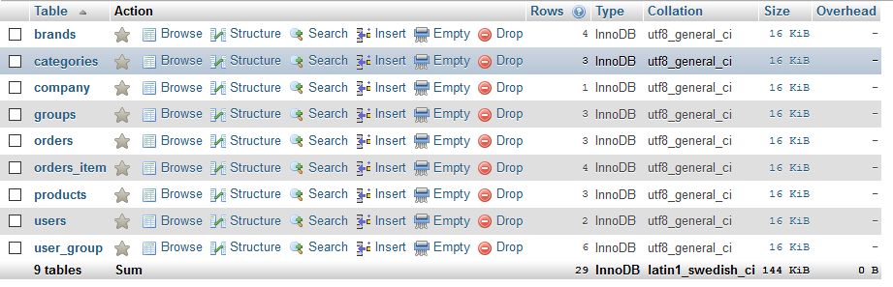
List of tables

Slide 48
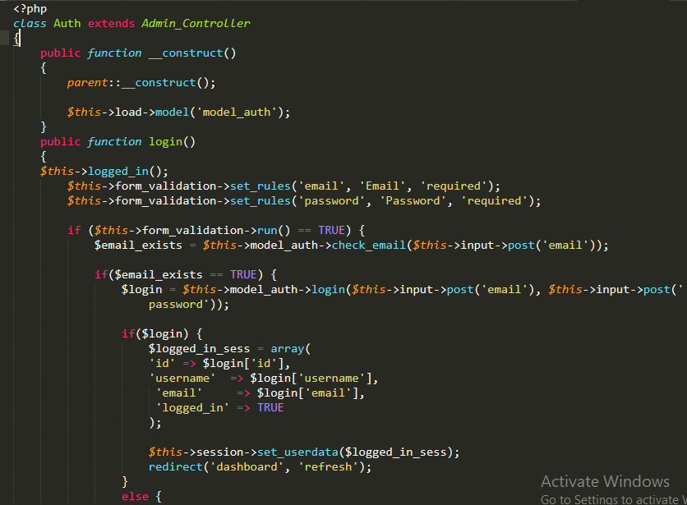
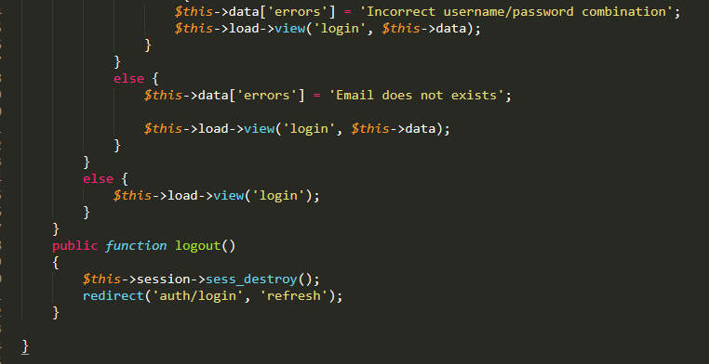
coding
Controller/Auth.php

Slide 49
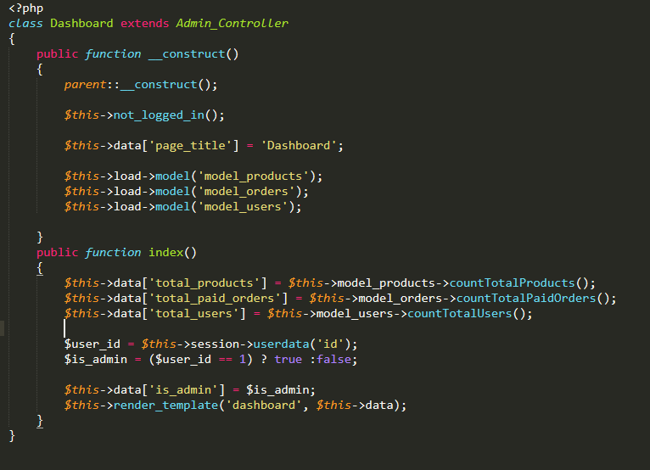
Controllers\Dashboard.php

Slide 50
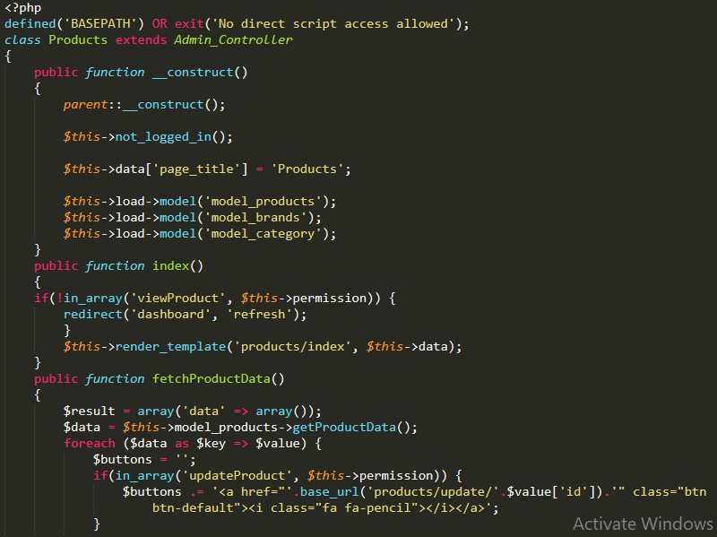
Controllers\Products.php

Slide 51
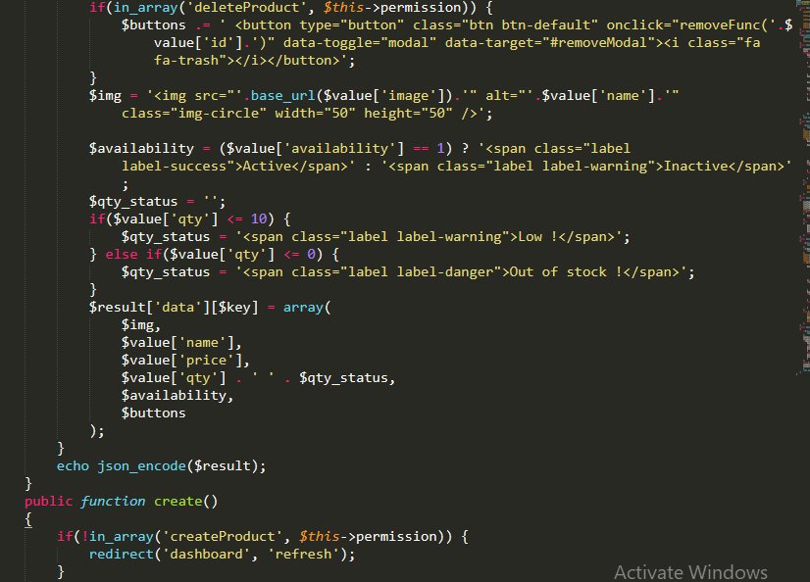

Slide 52
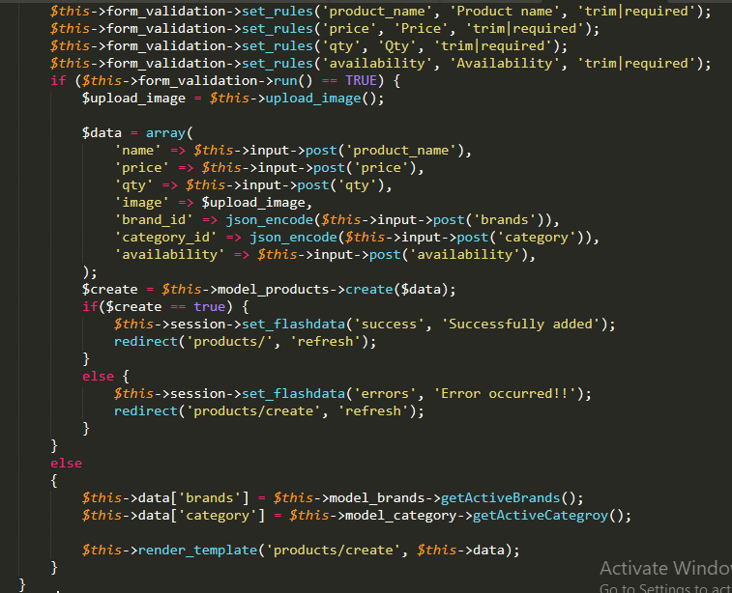

Slide 53
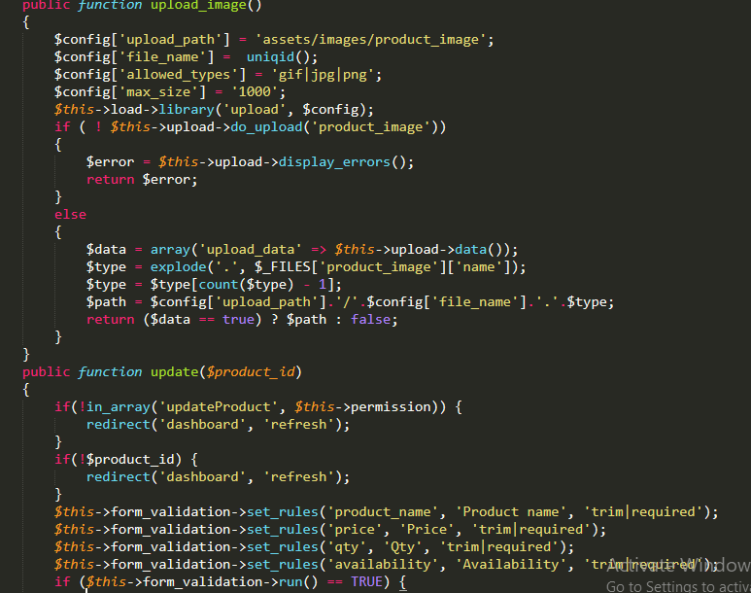

Slide 54
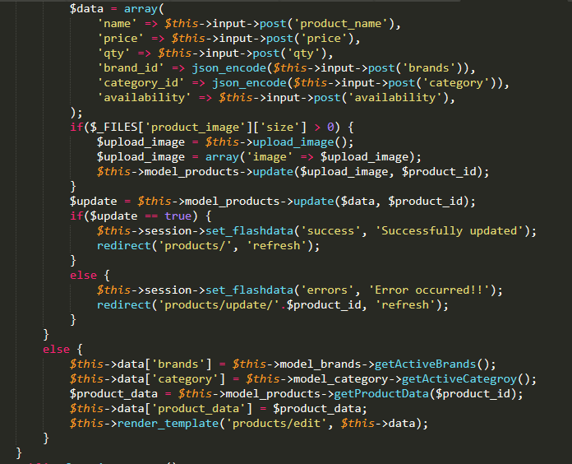

Slide 55
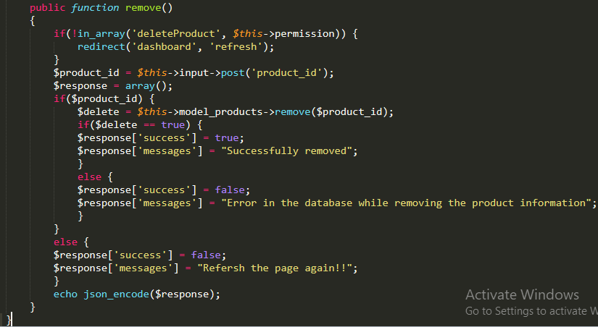

Slide 56
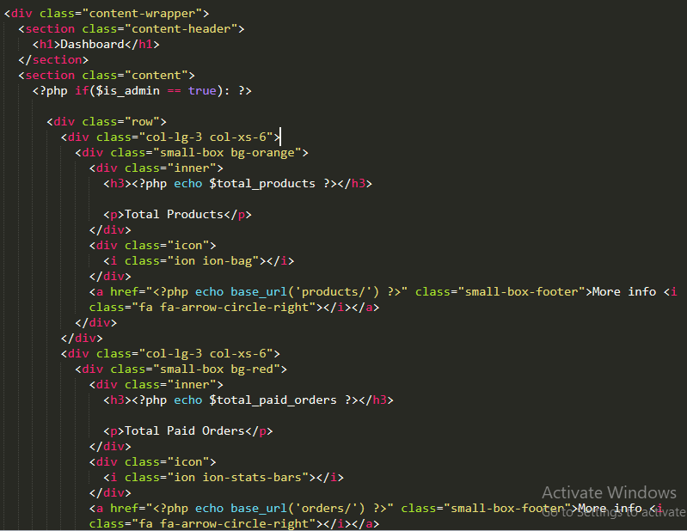
Views\dashboard.php

Slide 57
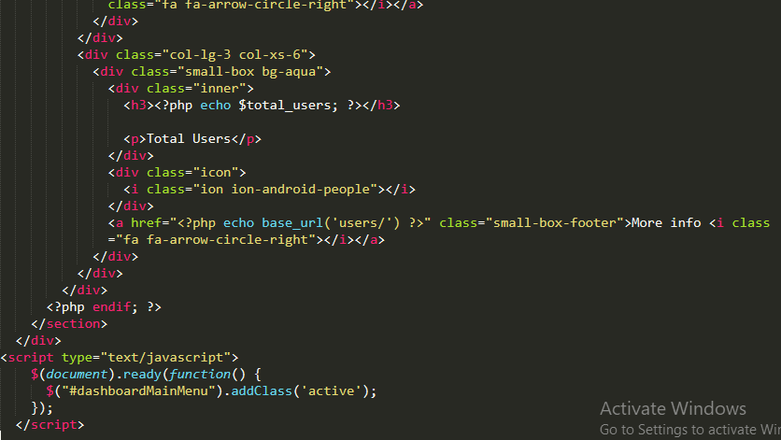

Slide 58
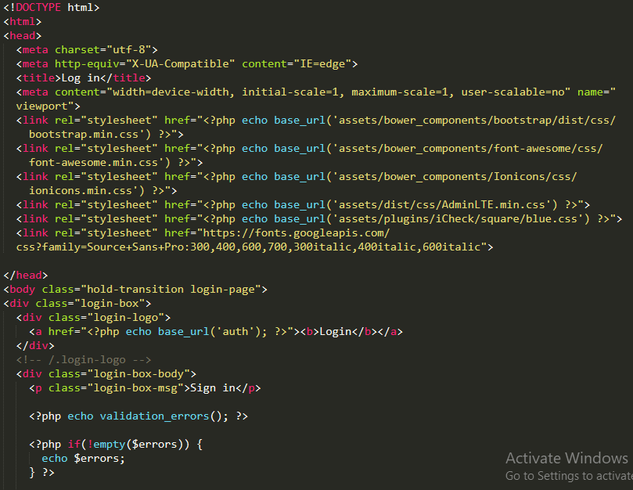
Views\login.php

Slide 59
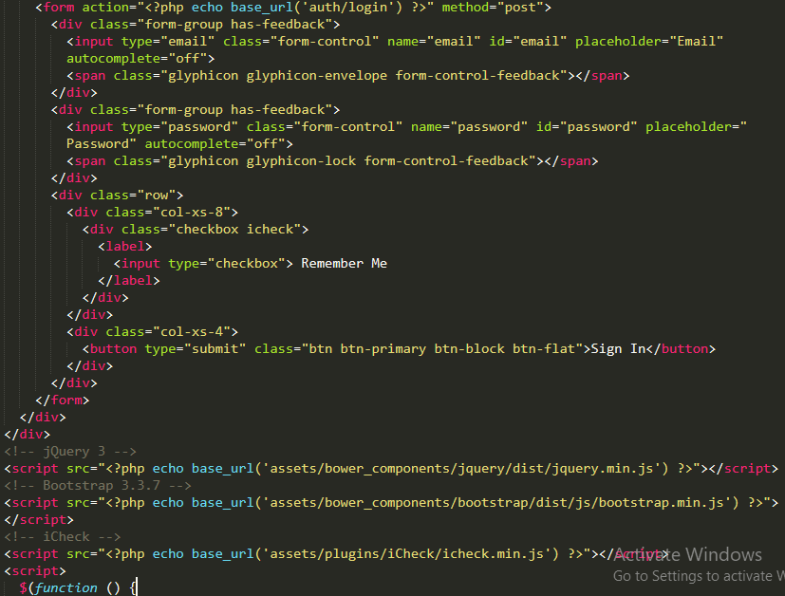

Slide 60
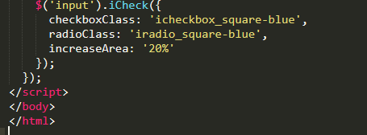

Slide 61
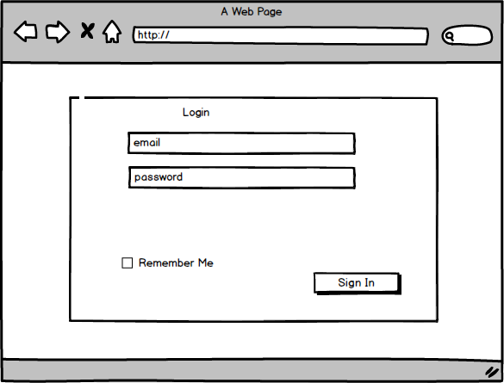
Ui design
Login

Slide 62
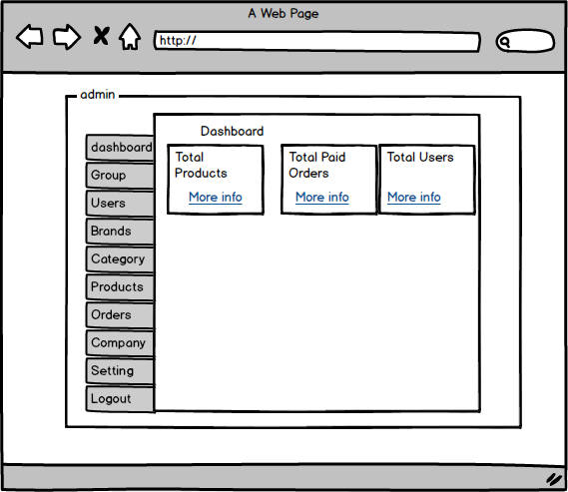
dashboard
Dashboard

Slide 63
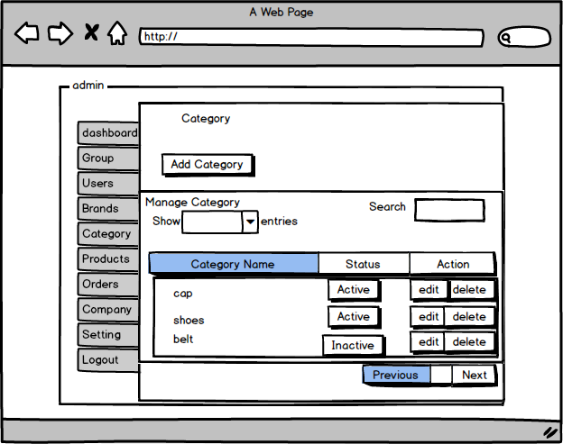
Display the category
Category

Slide 64
testing
Testing
It is the process of checking weather the software works properly or not.
It plays the vital role while developing the project as it provides the validation to the project. It helps to find out the error and solve it effectively. To do the test also there are many testing available like whitebox testing, blackbox testing, integration testing, etc. so, to complete this project here I used the two types of testing which are the blackbox testing and whitebox testing.

Slide 65
Blackbox testing
Blackbox testing
It is one of the best testing method which is used to test the functional part of the software and making sure that the behavior of the software is as expected.
So it is also know as the behavioral based testing.
It only look up to the functional part testing not the internal part of the software.
Just like the login, registration and other functional part of the software.

Slide 66
Test_id | Description | Test value | Expected result | Actual result | Pass or fail
Test_001 | Testing: empty value in the login form | Email= Password= | Message box with email field is required Password field is required. | The email field is required The password field is required. | Pass
Test_002 | Testing: inserting the invalid password in login form. | Email=admin@gmail.com Password=dh123f | Message box with incorrect email/password | Incorrect email/password | pass
Test_003 | Testing: inserting the invalid email and password | email=gita@gmail.com Password=nvdfkfenej | Message box with email does not exits. | Email does not exists | Pass
Test_004 | Testing: inserting the email but leaving the password box empty | Email=admin@gmail.com Password= | Message box with password field is required | Password field is required | Pass
Test_005 | Testing: inserting the password but leaving the email box empty. | Email= Password=12345678 | Message box with email field is required | Email field is required | Pass
Test_006 | Testing: inserting the correct email and password | Email=admin@gmailcom password=12345678 | Should open the dashboard | Opening the dashboard | Pass

Slide 67
Test_07 | Testing: changing the password with length is less than 8 characters | Password=1 23456 Confirm password=123456 | Message box with password field must be at least 8 characters in length | The password field must be at least 8 characters in length | Pass
Test_008 | Testing: changing the password which length is more than 8 charaters | Password=1234567890 Confirm password=1234567890 | Message box with successfully updated. | Successfully updated. | Pass
Test_009 | Testing: changing the email | Email=mandira@admin.com | Message box with successfully updated. | Successfully updated. | Pass
Test_0010 | Testing: changing the username | Username=mandy | Message box with successfully updated. | Successfully updated. | Pass
Test_oo11 | Testing: inserting the brand | Brand=Gucci | Message box with successfully added | Successfully added | Yes
Test_0012 | Testing: updating the brand | Brand=Gucci Status=inactive | Message box with successfully updated | Successfully updated. | Yes
Test_0013 | Testing: deleting the brand | Brand=Gucci Status=inactive | Message box with successfully removed | Successfully removed. | Yes

Slide 68
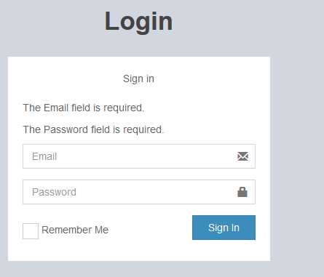
Test_id | output
Test_001

Slide 69
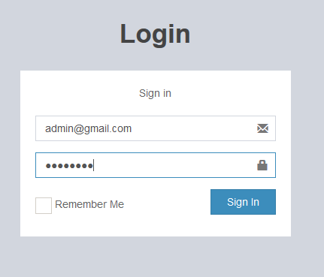
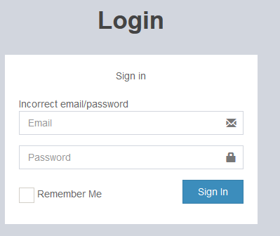
Test_id | Output
Test_002

Slide 70
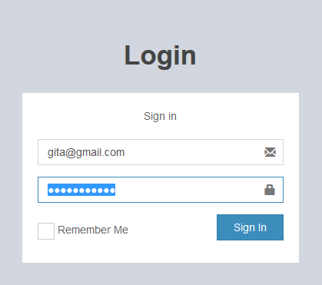
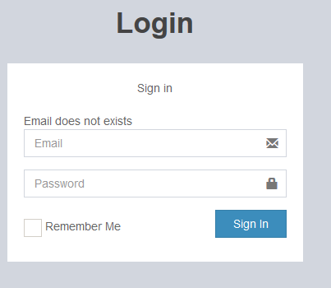
Test_id | Output
Test_003

Slide 71
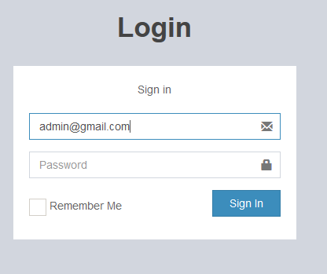
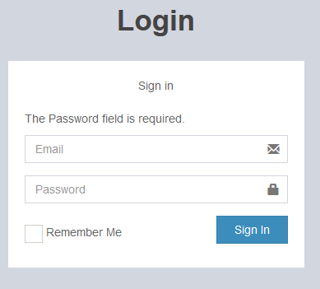
Test_id | Output
Test_004

Slide 72
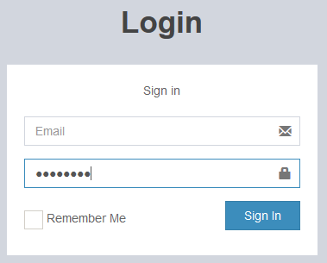
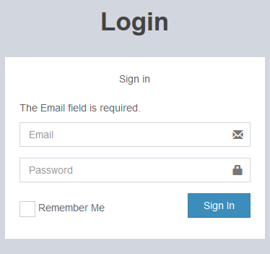
Test_id | Output
Test_005

Slide 73
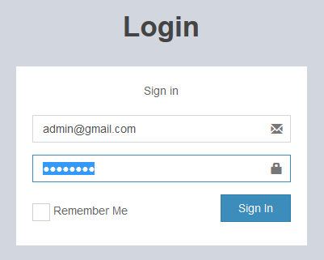
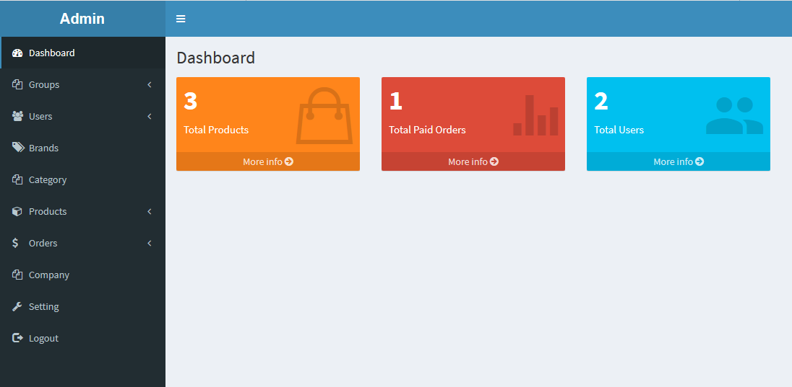
Test_id | Output
Test_006

Slide 74


Test_id | Output
Test_007

Slide 75


Test_id | Output
Test_008

Slide 76

Test_id | Output
Test_009

Slide 77

Test_id | Output
Test_0010

Slide 78


Test_id | Output
Test_0011

Slide 79


Test_id | Output
Test_0012

Slide 80


Test_id | Output
Test_0013

Slide 81
Unit testing
It is one the testing method which is used to test the software.
It test the internal parts of the software.
To use this test should have the knowledge of the programming and coding.

Slide 82


Unit testing

Slide 83



Slide 84
Future work
It is not only use for the business but also the shops as it is related to the product and its management in the systematic way.
If the admin wants to use the staffs to control the some features in the near future then they can allow it.
The admin can completely add and edit the new products.

Slide 85
limitation
The project is made under the step by step method with rules and regulation. We can say that the project works under the waterfall model.
The work flows like the waterfall so we cannot go back to the first step after entering the second step.
We cannot change it in the middle.
This project is not the online website which is only control by the admin so the outside user cannot open it.

Slide 86

User manual
Login

Slide 87
Login
Firstly the admin should enter the email/password.
The email/password should be validate.
If its valid then the admin is allowed to enter inside the system but in case of invalid, the admin will not be able to enter inside the system.

Slide 88


Add the product

Slide 89
Adding the product
After entering the valid email/password, the dashboard will open.
Click on the product which is in the side menu bar of the dashboard.
Click add product in the dropdown menu.
Insert the values in the form and click to add button to add the product.

Slide 90

Displaying the product

Slide 91
Display the product
After entering the valid email/password, the dashboard will open.
Click on the product which is in the side menu bar of the dashboard.
Click on the manage the product in the dropdown menu.
It display all the products of the warehouse.

Slide 92

Searching and sorting result->product

Slide 93
Searching and sorting result->product
After entering the valid email/password, the dashboard will open.
Click on the product which is in the side menu bar of the dashboard.
Click to the manage product in the dropdown menu.
On the top right side, there is search box where enter the search string.
It will appears the search result.

Slide 94

Delete the product

Slide 95
Deleting the product
After entering the valid email/password, the dashboard will open.
Click on the product which is in the side menu bar of the dashboard.
Click to the manage the product in the drop down menu.
All the product of warehouse is display in the form where there is also the delete symbol in the right side in the action field.
Click it and message box appears with ‘do you really want to delete?’
Click to yes button to delete the product.

Slide 96


Updating the product

Slide 97
Update the product
After entering the valid email/password, the dashboard will open.
Click on the product which is in the side menu bar of the dashboard.
Click to the manage the product in the drop down menu.
All the product of warehouse is display in the form where there is also the edit symbol in the right side in the action field.
Click it and the form appears.
Update the selected product in the form.
Click to the update button to update the product.

Slide 98


Adding the order

Slide 99
Add the order
After entering the valid email/password, the dashboard will open.
Click on the order which is in the side menu bar of the dashboard.
Click to the add order in the drop down menu.
Insert the value in the form and click to the add to add the order.

Slide 100


Print the order

Slide 101
Print the order
After entering the valid email/password, the dashboard will open.
Click on the order which is in the side menu bar of the dashboard.
Click to the manage order in the drop down menu.
All the orders are available in it and click to the print button which is show at the bottom of the form.

Slide 102

Bill of the product

Slide 103
Bill of the product
After entering the valid email/password, the dashboard will open.
Click on the order which is in the side menu bar of the dashboard.
Click to the manage order in the drop down menu.
All the orders are available in it and click to the print button which is show at the bottom of the form.
The bill is produce after clicking the print button.

Slide 104
conclusion
Finally the required stock management system was successfully designed and implement at the time. The web based system for managing the stock allow to edit the stock and record of it. It also keeps the record of purchase with billing and helps to edits the available products. With the help of different diagrams and methods the stock management system completed successfully without complications and obstacles.

Slide 105
references
https://en.wikipedia.org
http://www.tutorialspoint.com
https://www.carajaclasses.com
http://www.lynda.com

